Slide 1



STUDENT ENQUIRY DATABASE PROJECT
SUPERVISED UNDER PRINSHSU SIR

Slide 2
ROLES AND RESPONSIBILITIES
SIDHANT SEHGAL(Team Lead) – DEVELOPER
ALOK MISHRA – QUALITY ANALYST
RAJIB PRASAD – DATABASE ADMINISTRATOR
ABHILASH REDDY- PRESENTATION & DOCUMENTATION
SAI RAYAVARAM - DEPLOYMENT(GitHub)

Slide 3
Table of content
OBJECTIVE
TOOLS AND TECHNOLOGIES
SYSTEM CONFIGURATION
FEATURES
DATA FLOW DIAGRAM
TABLE CREATION ON MYSQL
TRANSFER TABLE MYSQL TO HDFS
TABLE CONFIGURATION
QUERY TABLE
DEMO STATUS TABLE
JOINING STATUS TABLE
PAYMENT TABLE
SOME OPERATIONS
CONCLUSION
REFERENCES

Slide 4
OBJECTIVE
An enrollment system combines all activities involved in the entire enrollment process and integrates them into a system. This way, everything happens in one place, both online and offline. The conversation happened with the prospects, their interests and motivations, their personal details, the meetings scheduled with them.
The overall objective of an enrollment system is to help admission teams ultimately enroll more students.

Slide 5
TOOLS AND TECHNOLOGIES
VIRTUAL MACHINE : CLOUDERA 5
ORC
SCOOP
GCP
HUE
EXCEL
GitHub
HIVE
MYSQL
HDFS
HADOOP 2.0

Slide 6
SYSTEM CONFIGURATION
WINDOWS / MAC:
8 / 16 GB RAM
512 GB SSD
512 GB HARD DISK
INTEL CORE I5 11 GEN
VIRTUAL MACHINE: CLOUDERA 5
4 GB MEMORY
64 GB HARD DISK
PROCESSORS : 1

Slide 7
FEATURES
Management team will be able to fetch number of students enrolled.
They can fetch the list of students who done the demo or missed the demo.
This project has features like update, delete and append a new set of rows.
Management team can perform bucketing and partitioning if required.
We can also perform CRUD operation on our payment table because of its ORC nature.
In this project all the tables overwritten from master table. So we do not need to update each table individually.

Slide 8
DATA FLOW DIAGRAM
QUERY TABLE
DEMO TABLE
DEMO DONE
DEMO
MISSED
JOINING TABLE
PAYMENT TABLE
NOT JOINED
JOINED

Slide 9
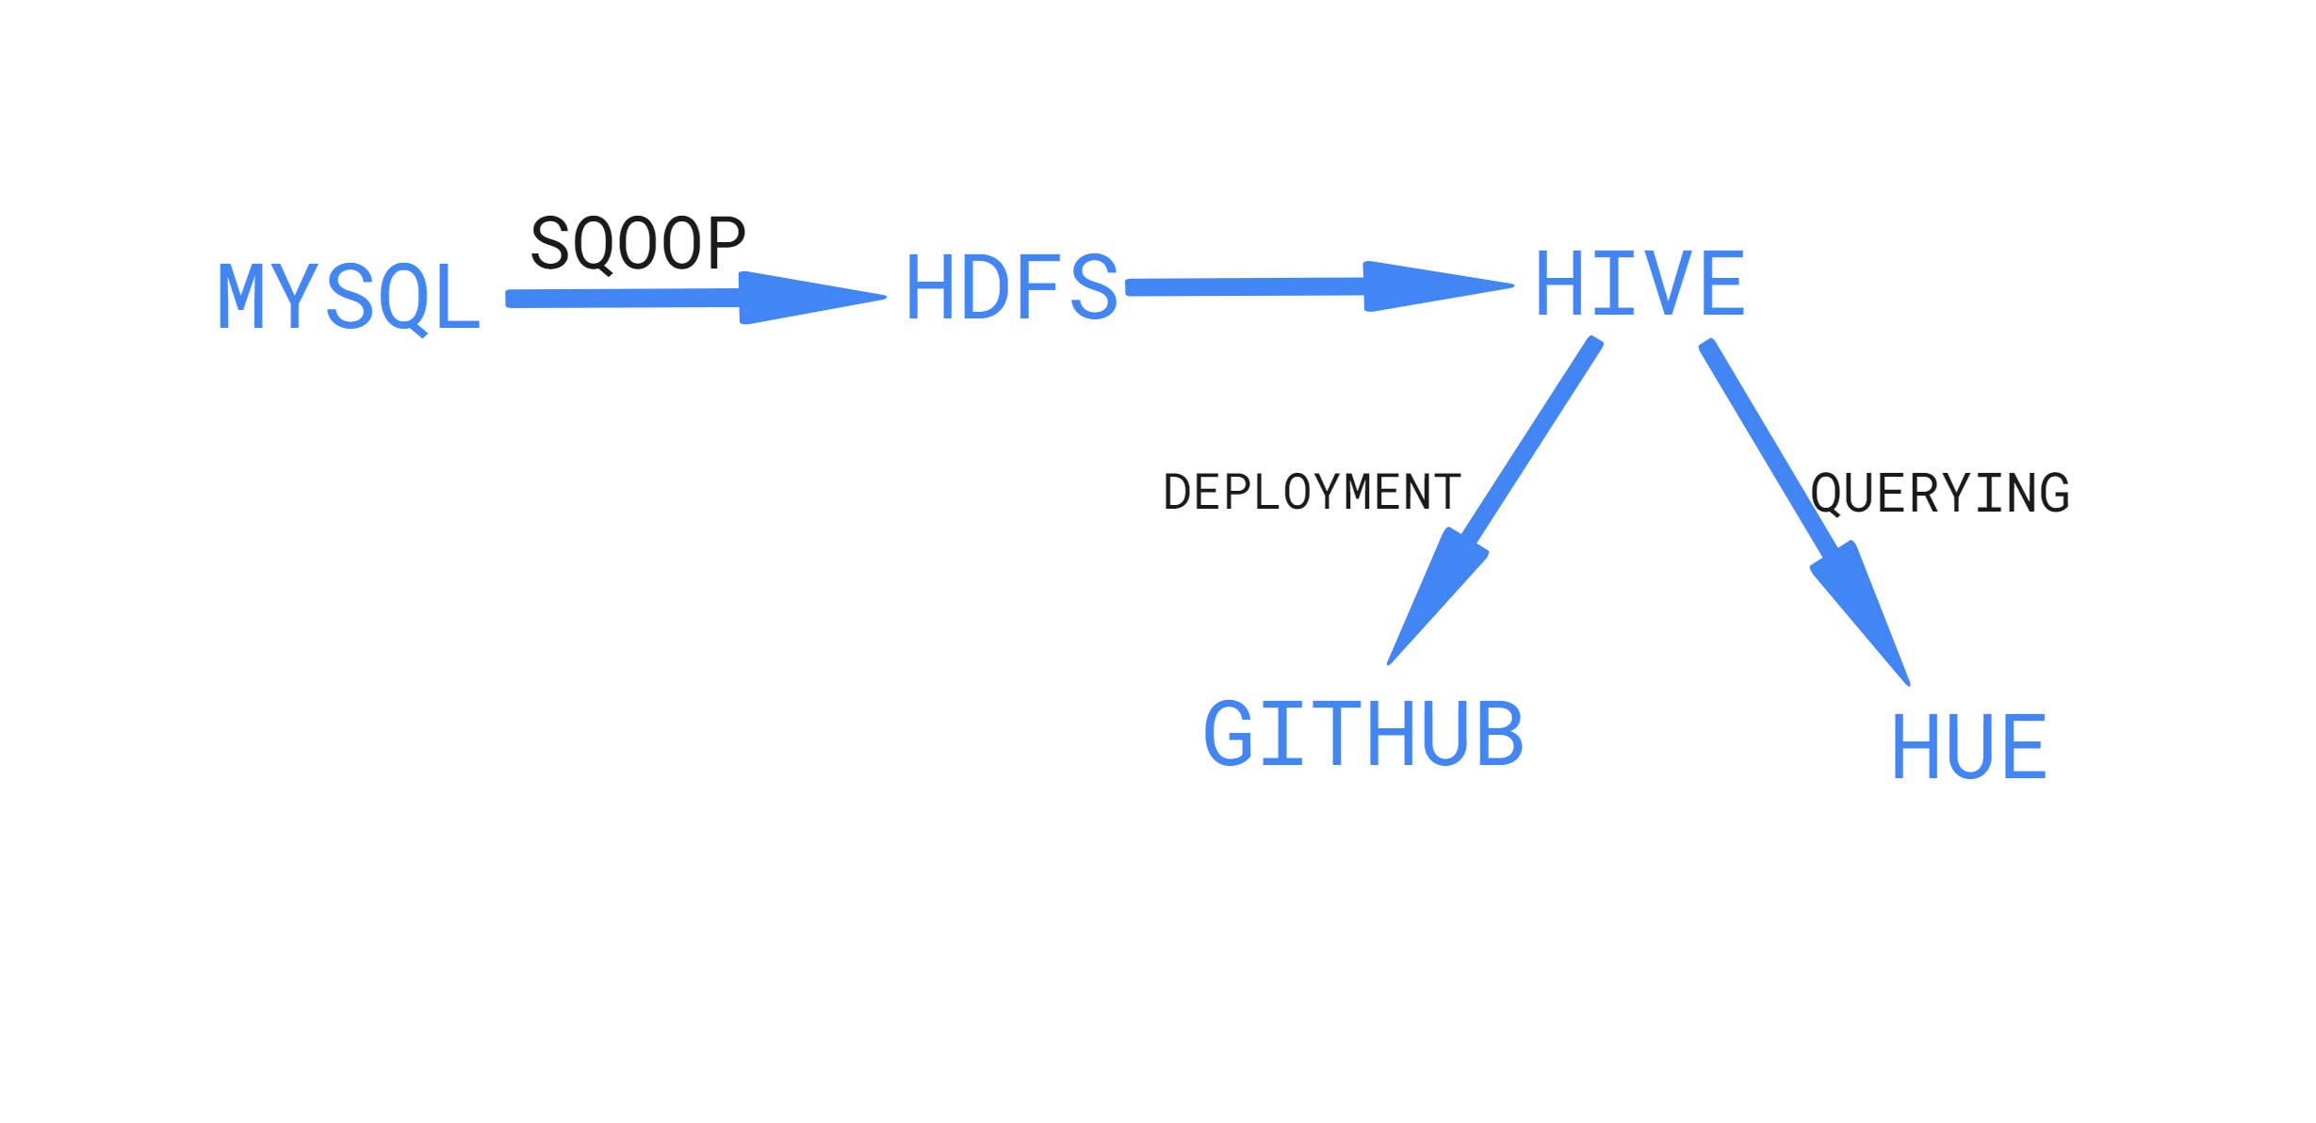

Slide 10
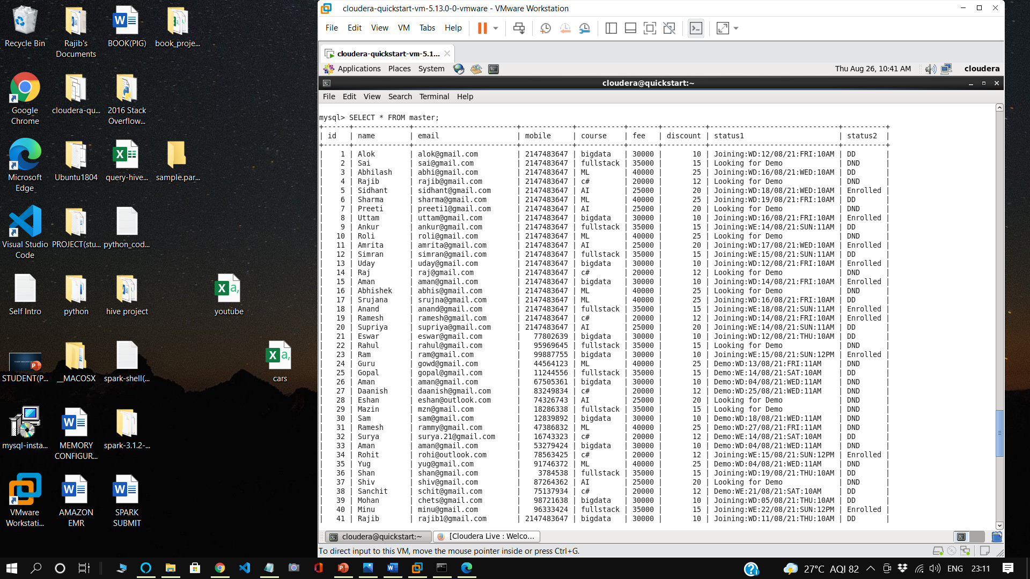
TABLE CREATION ON MYSQL
CREATE TABLE master id int, name varchar(255) NOT NULL, email varchar(255) NOT NULL, mobile int, course varchar(255) NOT NULL, fee int, discount int, status1 varchar(255) NOT NULL, status2 varchar(255) NOT NULL);
LOAD DATA LOCAL INFILE '/home/cloudera/Desktop/STUDENT_DETAILS' INTO TABLE master FIELDS TERMINATED BY ',' LINES TERMINATED BY '\n';

Slide 11
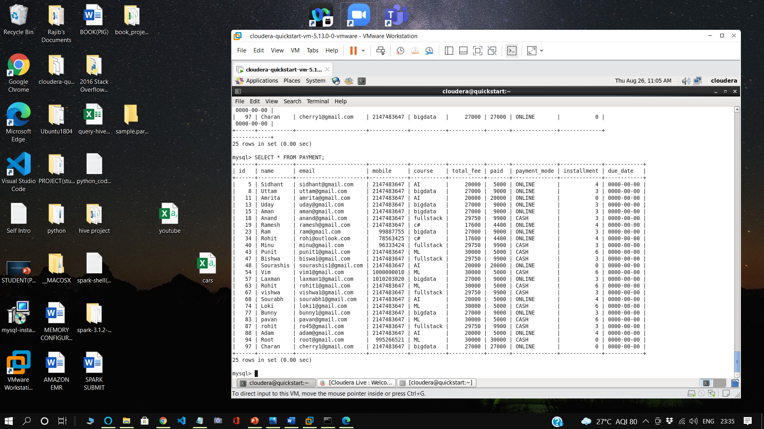
CREATE TABLE PAYMENT (id int, name varchar(255) NOT NULL, email varchar(255) NOT NULL, mobile int, course varchar(255) NOT NULL,total_fee int, paid int, ,payment_mode varchar(255) NOT NULL, installment int NOT NULL, due_date DATE);
LOAD DATA LOCAL INFILE '/home/cloudera/Desktop/payment_table' INTO TABLE master
FIELDS TERMINATED BY ',' LINES TERMINATED BY '\n';

Slide 12
TRANSFER TABLE FORM MYSQL TO HDFS
sqoop import --connect jdbc:mysql://192.168.150.132/RAJIB --username root --password cloudera --table master --target-dir /user/cloudera/master -m 1
sqoop import --connect jdbc:mysql://192.168.150.132/RAJIB --username root --password cloudera --table PAYMENT --target-dir /user/cloudera/payment_table -m 1

Slide 13
TABLES CONFIGURATION
Query Table: This is the master table, it contains details regarding the student such as the student id, name, email, mobile number, course which the student want to enroll, fee for the course, discount, etc.
Demo Table: This table contains details regarding student’s demo status like students attend the demo session or not, demo day, time etc.
DD - Demo Done, DND – Demo Not Done
Joining Table: This table contains details regarding student’s joining status like day of joining, course, total_fee, time etc.
Payment table: This table contains details regarding students who enrolled for the course. This table contains total-fee, paid, payment mode, installment, Due date etc.

Slide 14
QUERY TABLE
CREATING ORC MASTER TABLE:
create table master(id int, name string, email string, mobile bigint, course string, fee int, discount int, status1 string, status2 string) clustered by (id) into 4 buckets stored as orc tblproperties('transactional'='true’);
CREATING TEMPORARY TABLE:
create table temp (id int, name string, email string, mobile bigint, course string, fee int, discount int, status1 string, status2 string) row format delimited fields terminated by ',' lines terminated by '\n' stored as textfile;
LOAD DATA INTO TEMP TABLE:
load data local inpath '/home/cloudera/Desktop/demo_project/Master Table.txt' into table temp;
TRANSFER FROM TEMP TO MASTER:
insert into table master select * from temp;

Slide 15
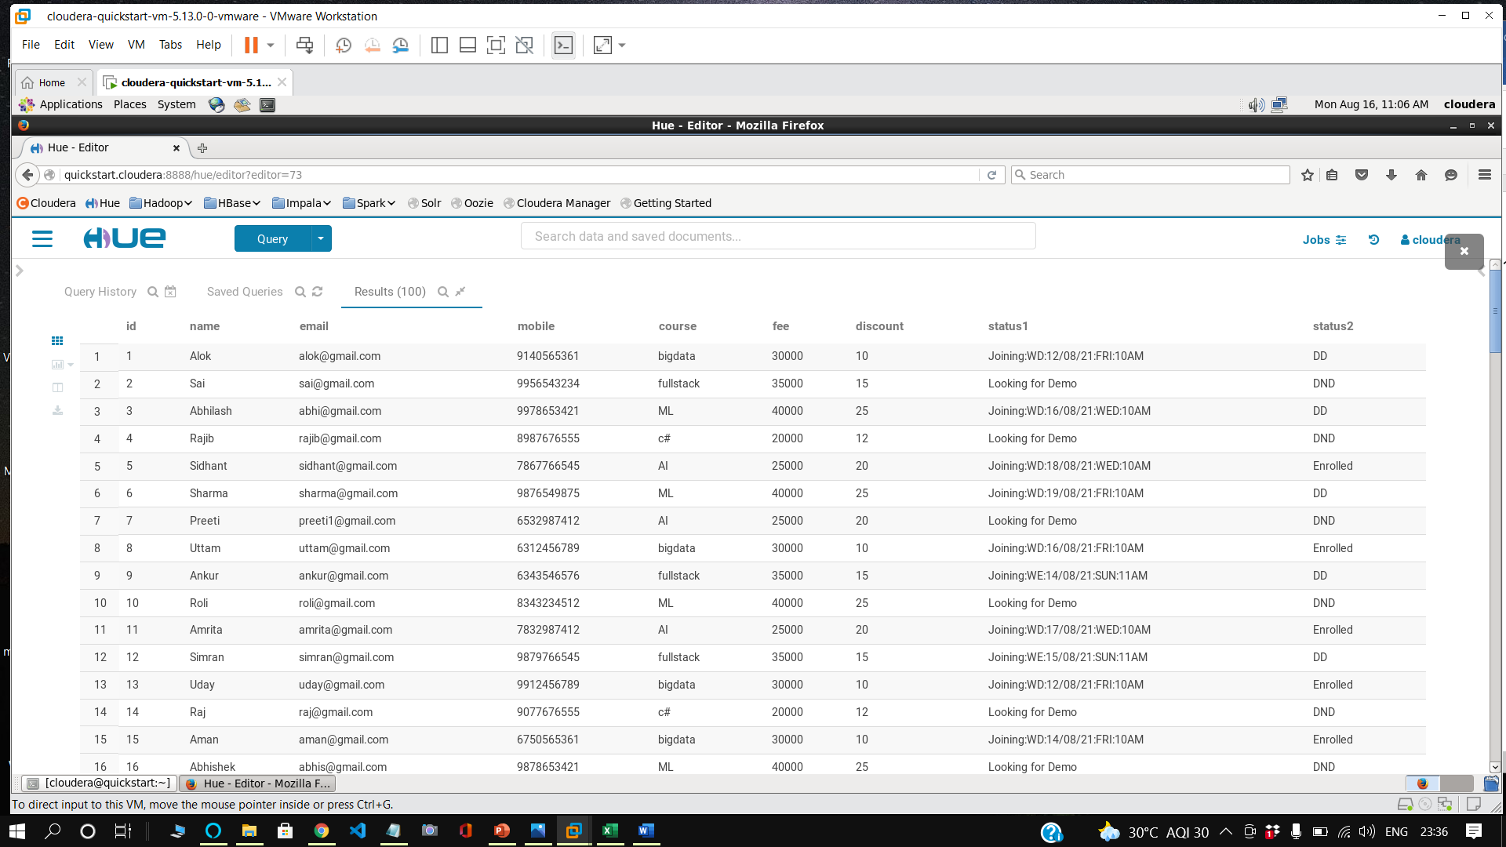
TABLE NAME: MASTER

Slide 16
DEMO STATUS TABLE
CREATE DEMO TABLE:
create table demo_table(id int, name string, email string, mobile bigint, course string, demo string, day string, time string) row format delimited fields terminated by ',' lines terminated by '\n' stored as textfile;
LOAD DEMO TABLE FROM MASTER TABLE:
insert overwrite table demo_table select id, name, email, mobile, course, status2 as demo, concat_ws(':',substr(status1,9,8),substr(status1,6,2),substr(status1,18,3)) as day, substr(status1,22,4) as time from master where substr(status1,1,4)=='Demo';

Slide 17
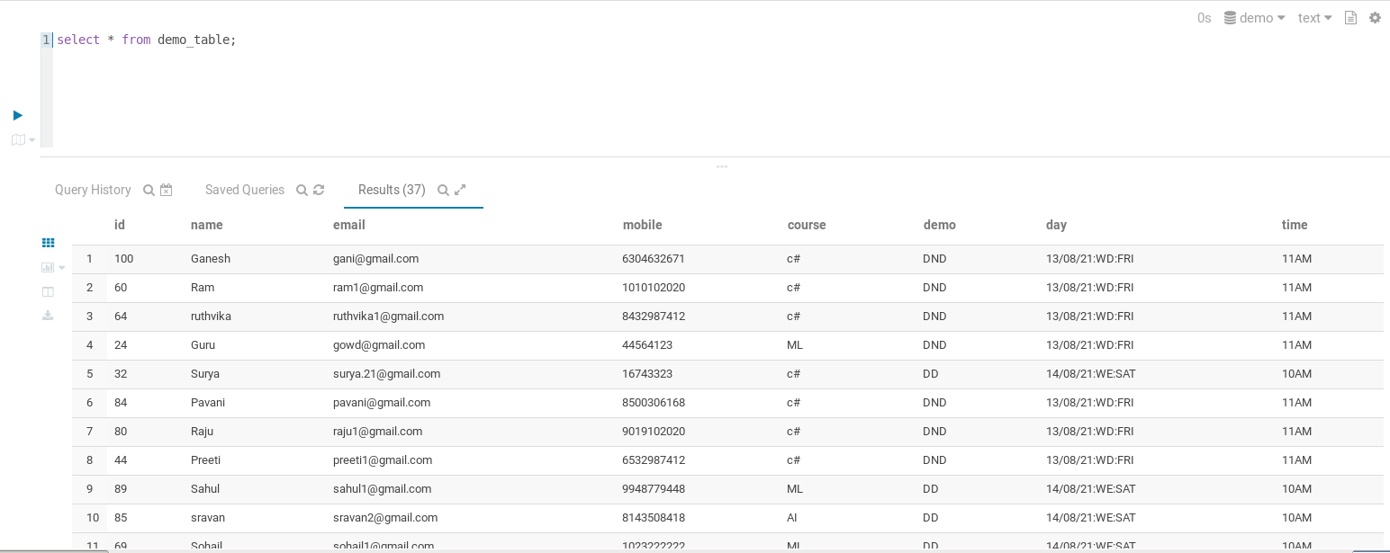
TABLE NAME: DEMO_TABLE

Slide 18
JOINING STATUS TABLE
CREATE JOINING TABLE:
create table joining_table(id int, name string, email string, mobile bigint, course string, joining string, day string, time string, total_fee float)row format delimited fields terminated by ',' lines terminated by '\n' stored as textfile;
LOAD JOINING TABLE FROM MASTER TABLE QUERY:
insert overwrite table joining_table select id, name, email, mobile, course, status2 as joining, concat_ws(':',substr(status1,12,8),substr(status1,9,2),substr(status1,21,3)) as day, substr(status1,25,4) as time, ((1-(discount/100))*fee) as total_fee from master where substr(status1,1,4)=='Join';

Slide 19
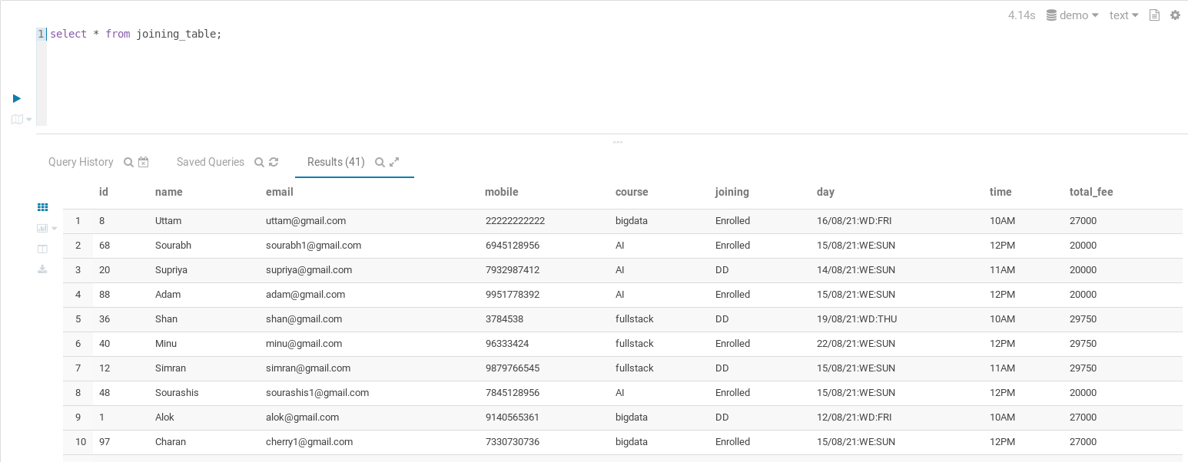
TABLE NAME: JOINING_TABLE

Slide 20
PAYMENT STATUS TABLE
CREATE TEMPORARY PAYMENT TABLE:
create table temp_payment_table(id int, name string, email string, mobile bigint, course string,total_fee float,paid float,payment_mode String,installment int,due_date String) row format delimited fields terminated by ','
lines terminated by '\n' stored as textfile;
LOAD DATA INTO TEMPORARY PAYMENT TABLE:
load data local inpath '/home/cloudera/Desktop/payment_table' overwrite into table temp_payment_table;
CREATE ORC PAYMENT TABLE:
create table payment_table(id int, name string, email string, mobile bigint, course string,total_fee float,paid float,payment_mode String,installment int,due_date String)
clustered by (id) into 2 buckets stored as orc tblproperties('transactional'='true’);
TRANSFER DATA FROM TEMPORARY TABLE TO ORC TABLE:
insert into table payment_table select * from temp_payment_table;

Slide 21
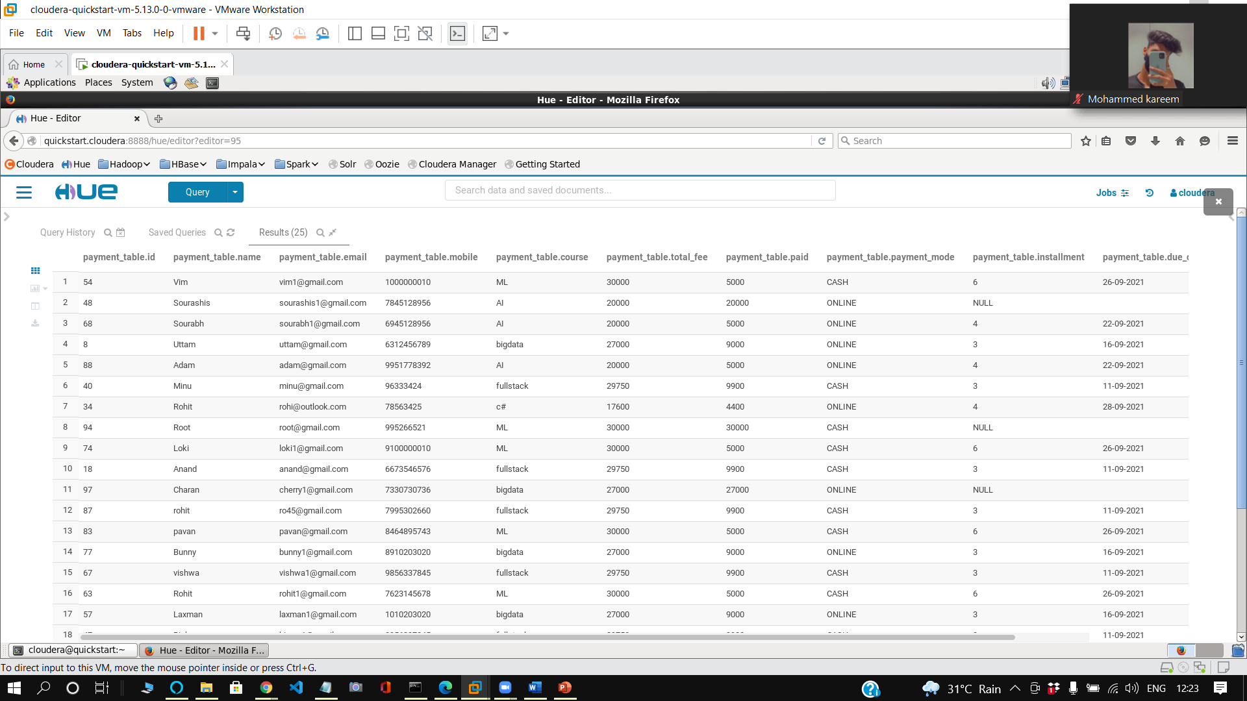
TABLE NAME: PAYMENT TABLE

Slide 22
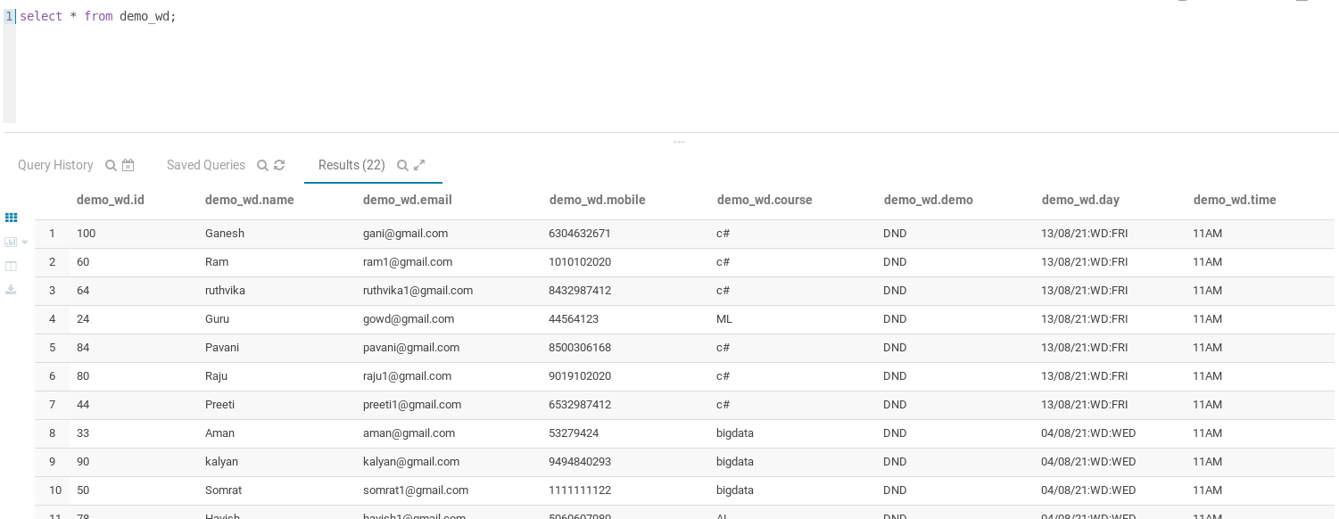
SOME OPERATIONS
DEMO WEEKDAY TABLE: (Students who book demo on weekdays)
create table demo_wd(id int, name string, email string, mobile bigint, course string, demo string, day string, time string) row format delimited fields terminated by ',' lines terminated by '\n' stored as textfile;
insert overwrite table demo_wd select id, name, email, mobile, course, status2 as demo, concat_ws(':',substr(status1,9,8),substr(status1,6,2),substr(status1,18,3)) as day, substr(status1,22,4) as time from master where substr(status1,1,4)=='Demo' and substr(status1,6,2)=='WD';

Slide 23
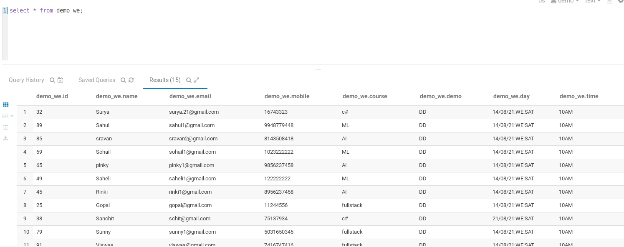
DEMO WEEKEND TABLE: (Students who book demo on weekdays)
create table demo_we(id int, name string, email string, mobile bigint, course string, demo string, day string, time string)
row format delimited fields terminated by ',' lines terminated by '\n' stored as textfile;
insert overwrite table demo_we select id, name, email, mobile, course, status2 as demo,
concat_ws(':',substr(status1,9,8),substr(status1,6,2),substr(status1,18,3)) as day, substr(status1,22,4) as time
from master where substr(status1,1,4)=='Demo' and substr(status1,6,2)=='WE';

Slide 24
CONCLUSION
In the course of this project we have learnt and become confident in handling the creation of databases, tables and the transfer of data through the system.
In conclusion, a database is a far more efficient mechanism to store and organize data than spreadsheets. It allows for a centralized facility that can easily be modified and quickly shared among multiple users.

Slide 25
REFERENCES
https://stackoverflow.com/questions/34198339/attempt-to-do-update-or-delete-using-transaction-manager-that-does-not-support-t
https://intellipaat.com/community/6520/loading-data-from-a-txt-file-to-table-stored-as-orc-in-hive
https://prwatech.in/blog/hadoop/hadoop-hive-test-case/

Slide 26
THANK YOU

